Slide 1
Lowertown Community Association
Committee Updates

Slide 2
About LCA
Community Association for all of Lowertown
Rideau Street to the Ottawa River, Rideau Canal to Rideau River
Incorporated under Ontario laws for not-for-profit corporations
Directors are elected annually by residents
The oldest community with the most heritage buildings
A concentration of services for the homeless
A major entertainment sector
A struggling farmer’s market
Today: reports from all Directors; an update from the Councillor

Slide 3
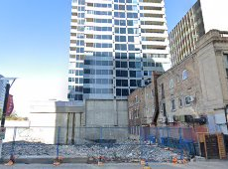
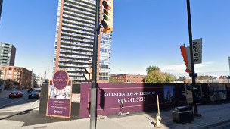
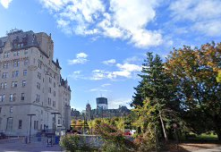
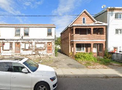
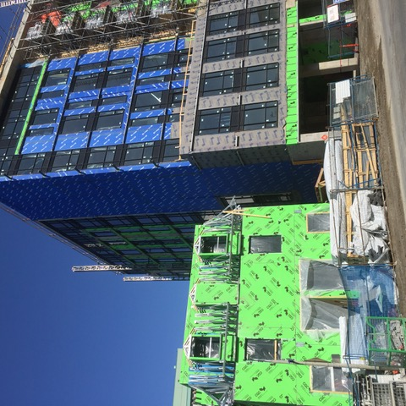
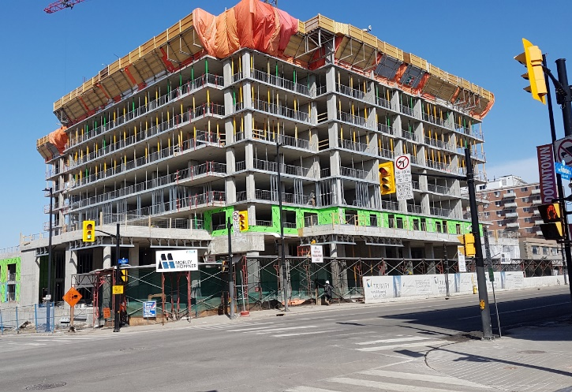
LCA Planning Committee Construction Approved
201-213 Rideau - Prince Development’s 24-storey hotel/condo between Dalhousie and Cumberland
180 George, 245 Rideau - Claridge Plaza, now under construction at the old Metro
73 Guigues - three-storey, seven-unit townhouse at Parent Avenue
1 Rideau - Approved Site Plan to construct an addition at the rear of the Château Laurier hotel
151, 153 Chapel - Trinity Development’s two, 25-storey residential towers
541-545 Rideau - Chenier Group’s 9 storey mixed use apartment building
180 George, 245 Rideau
201-213 Rideau
1 Rideau
73 Guigues
541-545 Rideau
151, 153 Chapel

Slide 4
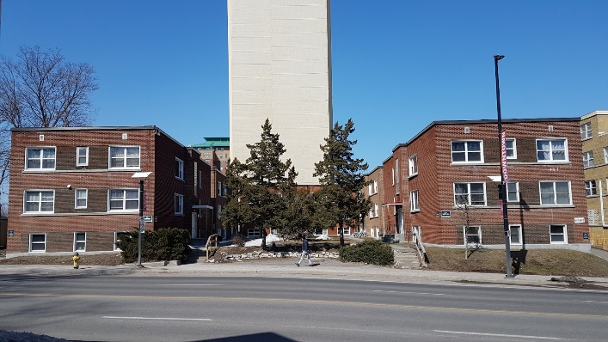
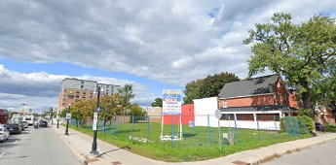
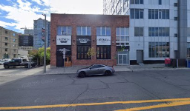
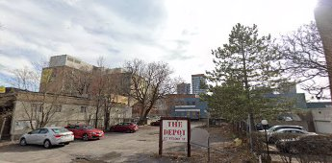
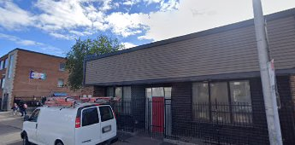
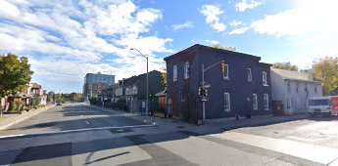
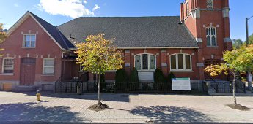
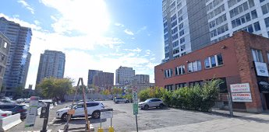
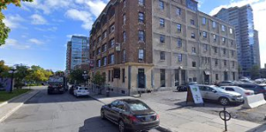
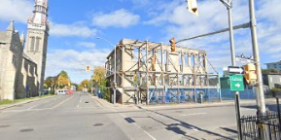
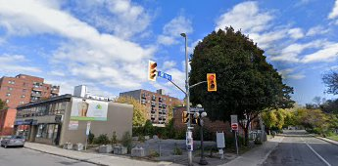
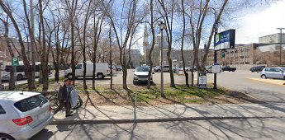
LCA Planning Committee In planning or with development potential
641 Rideau
260 Murray, 261, 269, 277 King Edward
112 Nelson
110 York & 137, 141 George
216 Murray
340 St. Patrick – Includes 287 Cumberland
284 King Edward
116 York
126 York & 151 George
175 York
385 Sussex

Slide 5
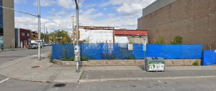
LCA Planning Committee Lowertown Sites: planning development potential
641 Rideau, 311-unit 25-storey tower sited on a 9-storey podium
260 Murray, 261, 269, 277 King Edward - 2016 proposal to build a 6-storey mixed-use development
112 Nelson – rezoned to permit a 9-storey residential building
110 York, 137 and 141 George - 19 story addition to the Andaz Hotel
116 York - 17-storey hotel
126 York & 151 George - potential 22 story apartment on George and converting the Major building on York into a hotel
175 York- vacant lot at Cumberland
284 King Edward - French Baptist Church
340 St. Patrick – Includes 287 Cumberland (Former site of Our Lady’s School) large site for sale, Frontage on 3 streets St Patrick, Cumberland, Murray
216 Murray – Shepherds of Good Hope proposal
385 Sussex – Notre Dame Cathedral Parking
111 Parent – Conversion of former Pier One Restaurant/Bar at Parent and Murray
111 Parent

Slide 6
Housing and Homelessness Committee
Advocacy (government, other CAs)
Focus spending on permanent housing solutions rather than emergency solutions
- Encourage city to use all tools at their disposal
Participation in Family housing Lab (VCA and others)
CAs, service providers, landlords and developers, the city assessing and piloting solutions to family homelessness
- Support for tax on vacant residential properties
Family circles, Vanier Development Corporation, housing loss prevention, head leases, engaging developers, diversion
Inclusionary zoning, right of first refusal, rental replacement bylaw, etc.
Encouraged the city to engage with private landowners and developers
Increase transparency and visibility on outcomes of funding

Slide 7
Housing and Homelessness Committee
Official Plan review
Participated in housing workshop with the Federation of Community Associations
Onus on market, not the city, to create affordability. Need for strong and widespread inclusionary zoning, engagement with nonprofits
10 yr H&H work plan and long- range financial plan review
No urgency, majority of the activities are visioning/analyzing/exploring
- Head leases
Lack of focus on outcomes, no clear link between workplan and 10 yr plan targets

Slide 8
LCA Safety and Security Committee
Community Engagement
Individual Residents and groups
Community Police and Neighbourhood Resources Team (NRT)
Councillor Fleury and staff
Vanier CA, Action Sandy Hill, Byward Business Improvement Areas (BIA) S&S, Rideau BIA, LERC
Ottawa Public Health, Causeway Needle Program, City of Ottawa (parks, forestry), NCC, By-Law, CPO
Identify and interact with various Outreach Services
Safety engagement for new business
Community Engagement for Prevention
Community Outreach: Ongoing community discussions
Police Engagement: Agent Status, Crime Trends, Crime Protect App, Regular Meetings
Walkabouts: Crime Prevention through Environmental Design (CEPTED)
OPH / Needle Hunter Program: # needles discarded / discarded Marijuana metal tube awareness
Outreach: Safety for individuals in public spaces
Neighbourhood Watch Program?

Slide 9
LCA Safety and Security Committee
Incidents – shooting, theft, trespassing, personal safety
Shooting 300 block of Murray – 15th March around 23:00 hours. No threat to public safety
Stabbing 0-100 block of Rideau st – 9th March around 18:45 hours. No threat to public safety
Arrests made 3rd March in relation to shooting 400 block of Dalhousie Street on 11th February
Car hit on driver’s side travelling north on King Edward Ave by a truck – 3rd March
Trespassing on condo property near Murray Street
Discarded drug paraphernalia, several locations
Safety in Parks and streets
Improperly discarded needles retrieved count by Ward conducted by City staff & Needle Hunters taken from OPH website - 2019 Ward 12 - 17,740 Ward 14 - 1,504
Dog Owners caution - discarded marijuana containers
Regular walkabouts required for debris, loitering, cleanliness, needles and other safety issues
SoGH 216 Murray St proposed build – Rapid Housing is good, concern of location next to SIS as safety concern for residents
Misc
Crime Trends and City Protect App
Routhier Centre

Slide 10
Communications and Outreach Committee
How does the LCA communicate with residents of Lowertown?
Monthly meetings and the AGM
Mail blasts through Mail Chimp. Have you signed up to receive these?
Postings and other information on the website www.lowertown-basseville.ca
Postings on our Facebook page facebook.com/LowertownBasseville Are you a follower of our page?
Through regular committee reports in the Lowertown Echo. Do you receive the Lowertown Echo de la Basse-Ville in your mailbox? Have you visited the new Echo website lowertownecho.ca?

Slide 11
Communications and Outreach Committee
LCA outreach in action
LCA board members and volunteers have many links to Lowertown organizations such as the ByWard BIA (Safety and Security), Lowertown Community Resource Centre, Lowertown Our Home and the Lowertown East Residents Committee. The LCA contributes $500 in support of the annual Winterfest which is organized by LERC.
Board members and volunteers on the various LCA committees have frequent contact with city officials on matters such as planning & development, heritage, transportation, environment, parks , and the ByWard Market

Slide 12
Communications and Outreach Committee
LCA outreach in action
The LCA is a member of the Federation of Citizens Associations of Ottawa, CAFÉ, other informal groups and has regular contact with Councillor Fleury and meets with the other community associations in Rideau Vanier ward
With the help of a hard-working crew of volunteers, the LCA operates and maintains the ice rink at Bingham Park.
The LCA has covered any losses incurred by the Echo over the past six years.
It has assisted the Councillor in mediating agreement among residents

Slide 13
Communications and Outreach Committee
How to communicate with LCA
Come to the monthly meetings where you can raise your concerns and ask your questions.
Use the contact form on the LCA website
Send an email: info@lowertown-basseville.ca
Get Involved!!!
Become a member of our working committees
Get elected to the LCA Board at the AGM
The communications team needs people to help with regular postings on our Facebook page, our various blogs, twitter account, Instagram to keep members of our community informed.

Slide 14
Communications and Outreach Committee
Some new ideas that are developing
Some people are trying to organize a major Lowertown community garage sale. What do you think?
There are active chapters of “Friends of Parks“ springing up that need nurturing and more hands on deck for clean-up, monitoring, beautification, and programming.
A number of neighbourhoods have organized successful street parties as a way to promote community. Can we share the knowledge on what it takes and what to expect when starting out?

Slide 15
Federation of Citizens Associations of Ottawa
LCA one of ~44 active FCA members
www.fca-fac.ca
General meetings occur monthly
Membership cost: $35 annually
LCA Board member Catherine Hacksel also an FCA Board Member
Current FCA Priorities: New Official Plan
FCA has hosted four workshops on the OP relating to: housing, transects & overlays, greenspaces, and 15 minute neighbourhoods
FCA has written to the city requesting a delay in OP process due to the pandemic
FCA encourages Community Associations’ to contact their City Councillors, gearing to support CA’s newer to municipal advocacy (currently preparing a toolkit & workshop on approaching your Councillor)
FCA representatives plan on meeting with City OP team directly this spring
Active Committees: Constitution (currently being reviewed), Transportation, and Planning

Slide 16
Heritage Committee

Slide 17
Heritage Committee

Slide 18
Heritage Committee

Slide 19
Transportation Committee
Traffic and Transportation
King Edward Avenue Traffic:
Long term goal is to raise funds to implement pre-approved traffic calming measures and finding new ways to slow vehicles down:
Widening of centre lane is least expensive and will result in wheel traffic being moved away from current manholes, hopefully putting a stop the vibrations felt by neighbours when heavy trucks go by.
Exploring way in which to restrict trucks to only using “fast lane”
Exploring ways in which to have speeding camera installed.
Short term goals are to find effective ways to slow vehicles down by using flex posts and signs.
Interprovincial Crossing:
LCA has teamed up with Action Sandy Hill and requested a meeting with Tim Tierney to ensure we are kept aware about the ongoing consultations between NCC and the City regarding the Interprovincial Crossing Study currently in the works. Meeting is yet to take place.

Slide 20
Arts & Culture Committee Activities
Mural project in the Byward Market
Join us April 13!
Vintage pop-up in Lowertown
Know a location?
Input on artist-in-residence program (Rochon House)
Share your thoughts
New members + exploring partnerships with businesses

Slide 21
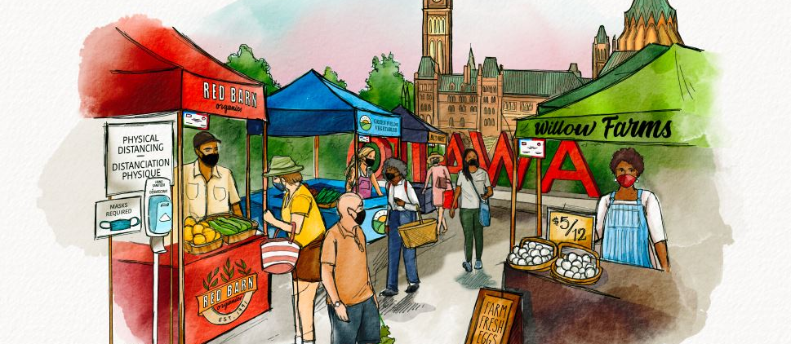
Celebrate Ottawa Farmers and the Chefs of ByWard
every Saturday this summer!
Fêtons les cultivateurs d’Ottawa et les chefs cuisiniers du ByWard
tous le samedi matins cet éte !

Slide 22
Environment and Active Transportation Committee
Traffic and Transportation
Advocating for Investment in active transportation, treescape and public realm improvements in the ByWard Market and funding for the Plan
Advocating for municipal climate action – Climate change master plan and Energy Evolution Strategy
New Official Plan and associated master plans that impact the environment (all!)
Urban forestry and new Tree By-law
Active transportation led by John Wodehouse-Snow Moles – advocating for connectivity of cycling/pedestrian infrastructure in ByWard, LRT station, St Patrick, key connections, etc.
Serving as Chair of Community Association Forum for Environmental Sustainability (CAFES) – Coordinating concerted action across Ottawa and at City Hall, Capacity Building of CAFES
Advocating for protecting the Rivers, stop nuclear waste dump at Chalk River etc.
Solid waste management, particularly single use plastics reduction

Slide 23
Environment and Active Transportation Committee
Traffic and Transportation
Friends of Lowertown Parks (FoLP) collaborative: Started August 2020
City of Ottawa Parks included: Bingham, Bordeleau, Cathcart Square, Cumberland, Jules Morin, Linear, MacDonald Gardens, Raphael Brunet, Rose Parks.
NCC Parks: King Edward, Majors Hill, Nepean Point Parks
Accomplishments to date: Connections with the various City departments, NCC and Councillor’s office promoting collaboration between local community and park management
Working towards inspiring pride in conserving our green spaces
Clean-up the Capital: Check the City of Ottawa website for Clean-up dates in the park

Slide 24
Conclusion: What’s Next
New members and new Executives
Working with key partners
AGM- October: review our progress, elect Directors
May 10 Community Meeting

